Slide 1
WeFly Executive Summary
The Airline Industry Rebounds from Unfortunate Incidents

Slide 2
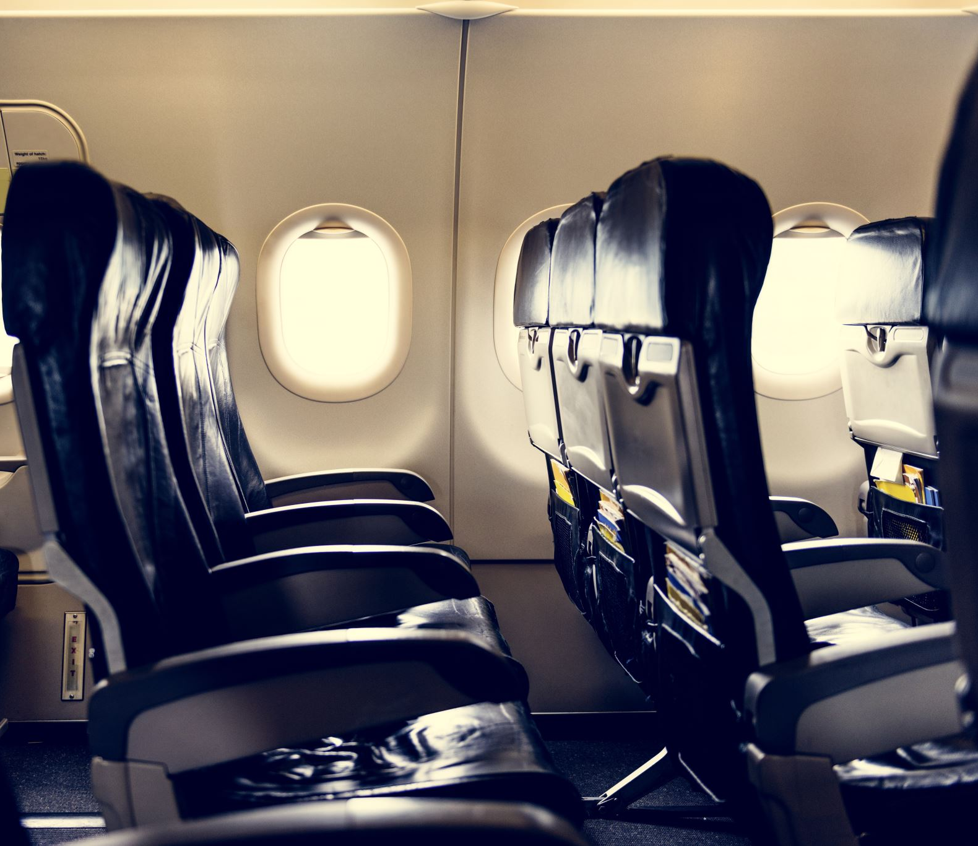
United Airlines Captain shows the passengers are part of the experience.
“Not while I’m in charge. Just know I’ve got your back,” he insists. “So, let’s be kind. Let’s work together as a team.”

Slide 3
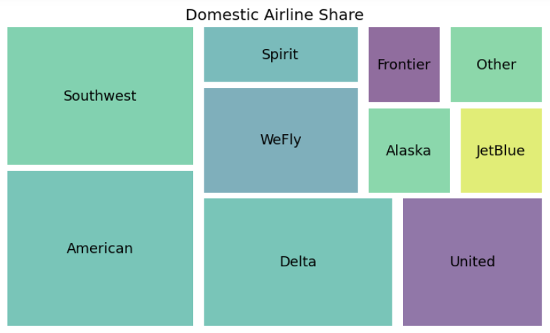
WeFly Market Share Holding at 11% domestic air flights
11%

Slide 4
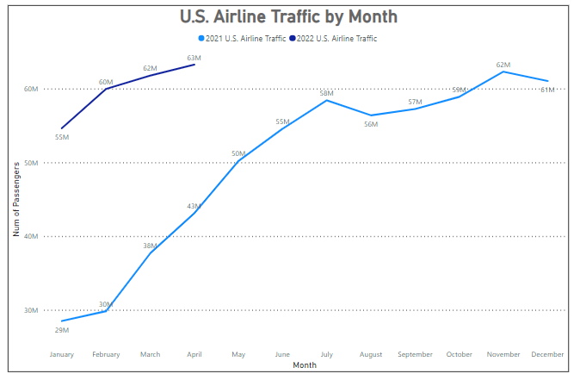
The Trend of Airline Traffic

Slide 5
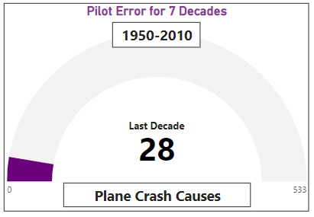
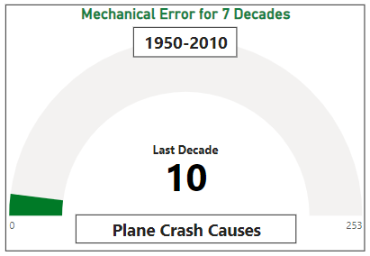
Mitigate Human Error
Largest Factors when it comes to plane crashes.

Slide 6
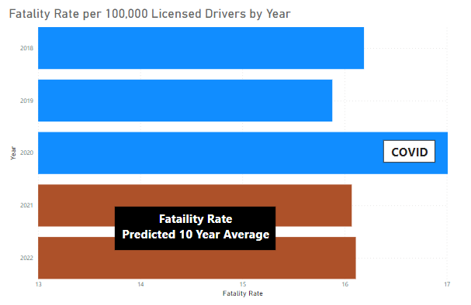
Fatality Rate per 100K Vehicle Drivers

Slide 7
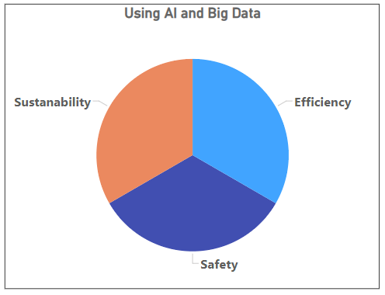
Future of WeFly NEXT LEVEL performance opportunity

